Slide 1


Introduction to Advanced Heart Failure Therapies
ECHO IDAHO
Managing Heart Failure
in Primary Care
2/05/2026
Preethi Pirlamarla, MD
Assistant Professor, Advanced Heart Failure and Cardiac Transplant
University of Washington
Chris Longenecker, MD reported a financial relationship with Gilead Sciences as being on their Advisory Board on HIV. This relationship was deemed irrelevant in his role as a panelist in this series. None of the other planners or presenters for this educational activity have relevant financial relationship(s) to disclose with ineligible companies whose primary business is producing, marketing, selling, re-selling, or distributing healthcare products used by or on patients.

Slide 2
Learning Objectives
Identifying the features that are associated with Advanced Heart Failure”
Identifying the options for patients with Advanced Heart failure
Identifying the indications and contraindications of Cardiac Transplant and Left Ventricular Assist Devices (LVADs)
Identifying the components of a LVAD and its general mechanism of action
Understands the basics of Cardiac Transplantation and LVAD therapy

Slide 3
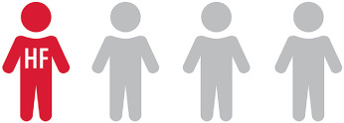
Heart Failure by Numbers
Approximately 6.7 million Americans over 20 years old carry a diagnosis of heart failure. With expected projections of:
8.7 million in 2030
10.3 million in 2040
11.4 million in 2050
In 2020, it was estimated that HF was responsible for $32 billion in direct costs and an additional $14 billion in indirect costs
Lifetime risk of HF has increased to 24%- approximately 1 in 4 Americans will develop heart failure in their lifetime
Heart failure mortality rates have been increasing since 202 with heart failure accounted for 45% of cardiovascular deaths in 2021
Among patients 65 years and older, patients who have been hospitalized with heart failure have an estimated mortality rate of 35% at 1 year post discharge
In 2021 there was 1.2 million primary HF hospitalizations
HF STATS 2024: Heart Failure Epidemiology and Outcomes Statistics An Updated 2024 Report from the Heart Failure Society of America
Bozkurt, Biykem et al.
Journal of Cardiac Failure, Volume 31, Issue 1, 66 - 116

Slide 4
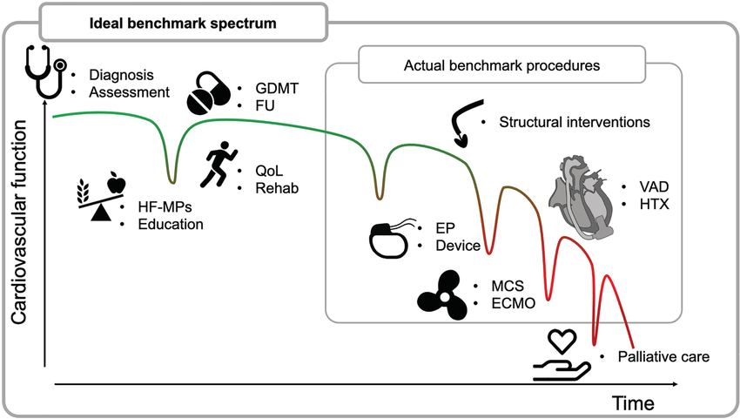
Why do we care about Heart Failure?
1- Year Mortality
Stage A: 2-3%
Stage D: >50%
*This mortality rate is IRRESPECTIVE of ejection fraction*
DOI:10.1002/ehf2.14266

Slide 5
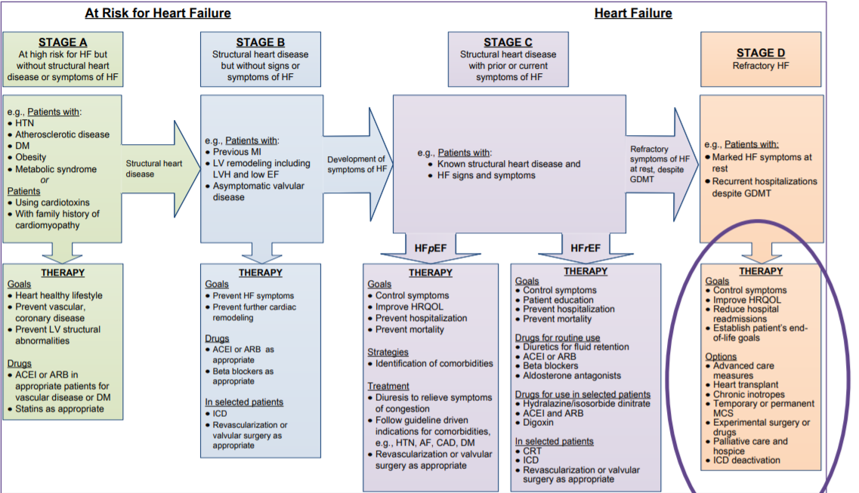

Slide 6
Characterizing the Advanced HF phenotype
Functional Class
Intermacs Class
Exercise Capacity (Peak Oxygen consumption)
Clinical Events/Landmarks

Slide 7
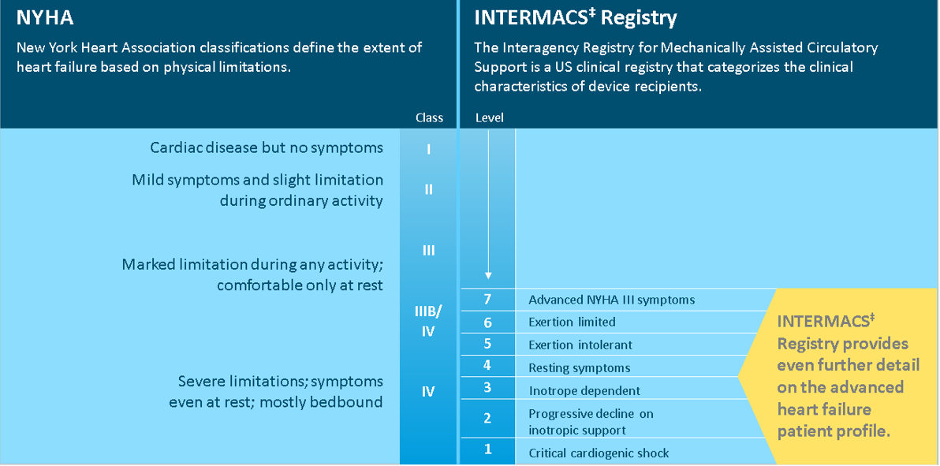

Slide 8
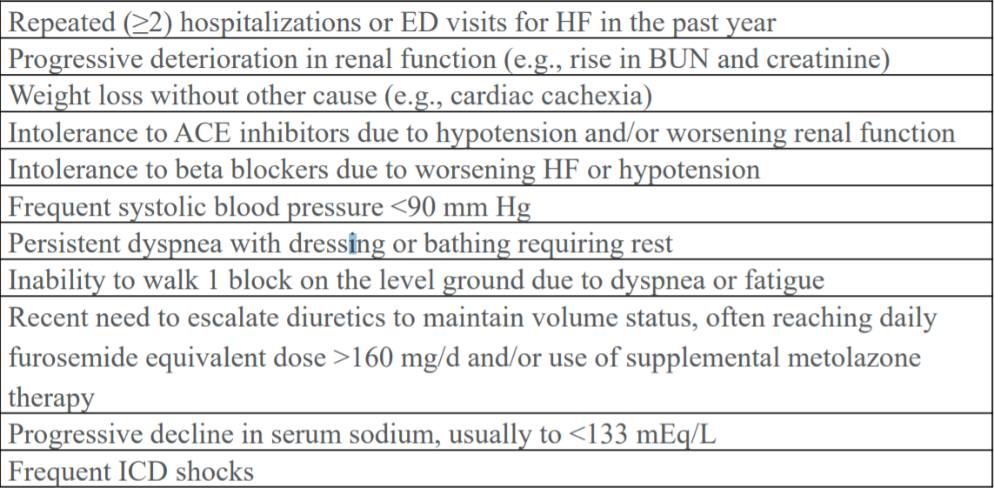
Clinical Events
Additional considerations:
Use of inotropic medications
CRT “Non-responders”
Yancy, CW et al. 2013 ACCF/AHA Heart Failure Guideline

Slide 9
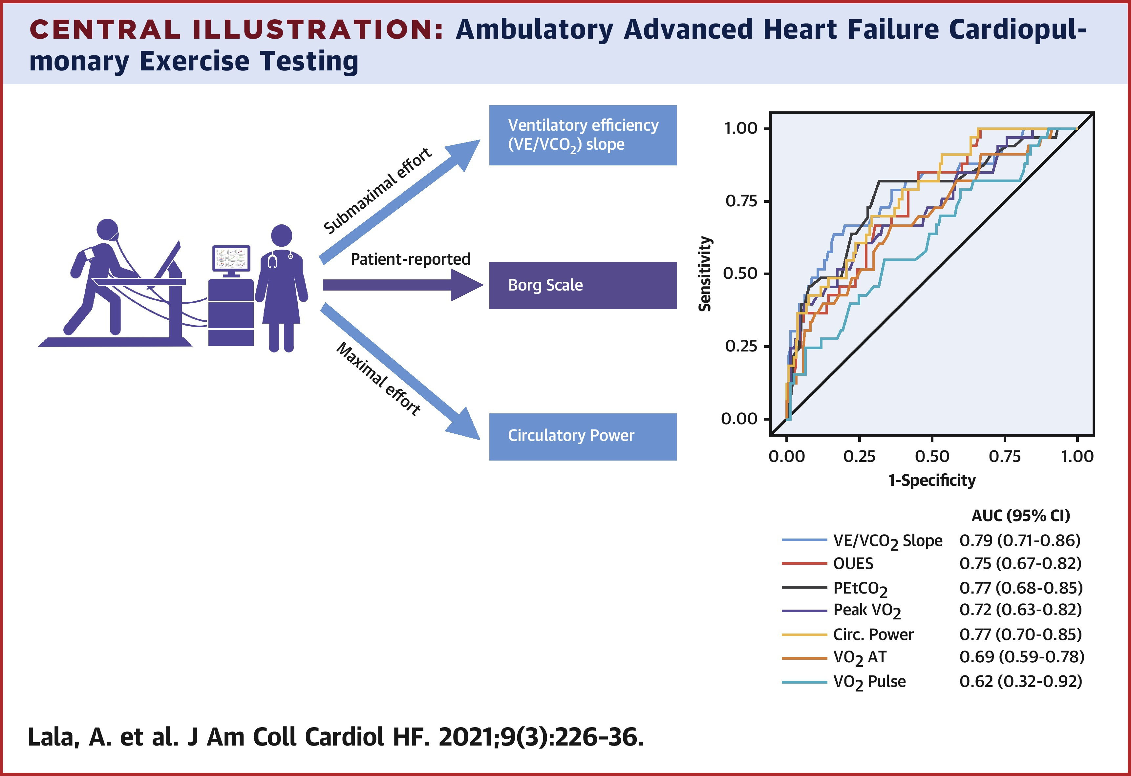
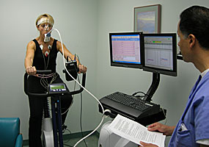
Prognosis- Cardiopulmonary Exercise Testing
C.O. = VO₂
13.6*HgB*(S_{A}O₂-S_{V}O₂)

Slide 10
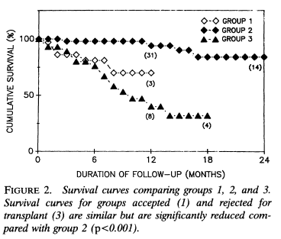
Prognosis - Cardiopulmonary Exercise Testing
Peak VO₂ >14 ml/kg/min predicts clinical stability over the next 1 year.
Peak VO₂ <14 ml/kg/min is the cut-off for a patient needing advanced therapies
Circulation. 1991 Mar;83(3):778-86. doi: 10.1161/01.cir.83.3.778

Slide 11
Where to next?
Advanced Heart Failure
Left Ventricular Assist Device
Heart Transplantation

Slide 12
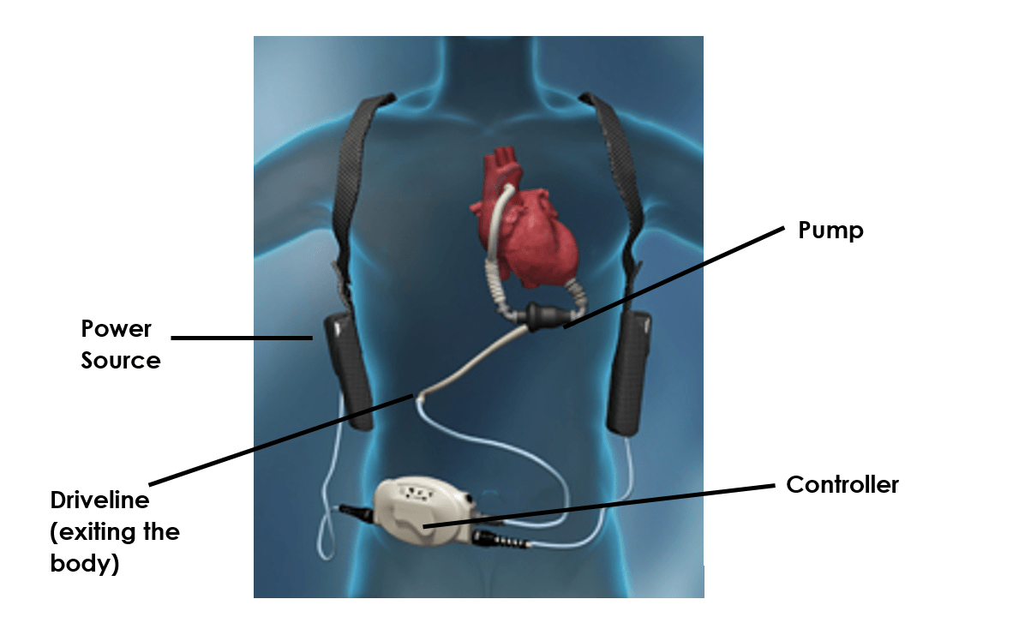
Left Ventricular Assist Devices (LVADs)
Surgically implanted durable mechanical circulatory support device
Designed to unload the left ventricle and circulate blood to the aorta and subsequently leads to end organ perfusion
Can be implanted as:
Destination Therapy
Bridge to Transplant

Slide 13
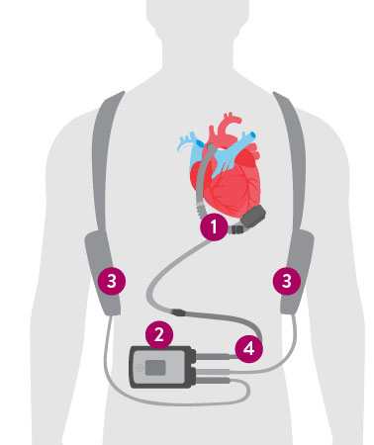
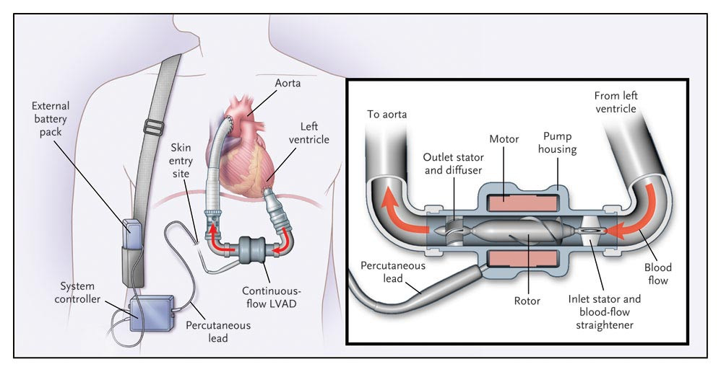
LVAD Components
Notes:
In terms of basics, there are basic components
Pump with inflow cannula
Outflow graft that is sown onto the aorta
Pump needs power
Percutaneous lead that goes from pump to controller- called the driveline
Batteries to run

Slide 14
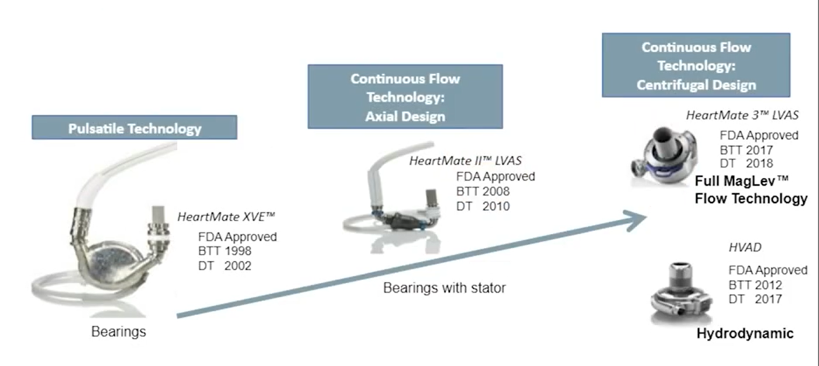
Ventricular Device Innovation
Notes:
1st Generation: HeartMate XVE- studied in REMATCH (landmark trial). Significant design flaws- pulsatile nature. Mechanical error over time so wasn’t durable
2nd Geneartion: HeartMate II- continuous flow design (axial flow). Long axis of rotor is parallel to blood flow. Error- rotor suspended by two ruby bearings-lead to heat production- activates the coagulation cascade- more prothrombotic and stroke risk
3nd Generation: HeartMate 3- continuous flow but centrifugal design. Axis of rotation is perpendicular to blood flow. Full magnetic levitation technology- rotor sits in middle of casing without friction

Slide 15
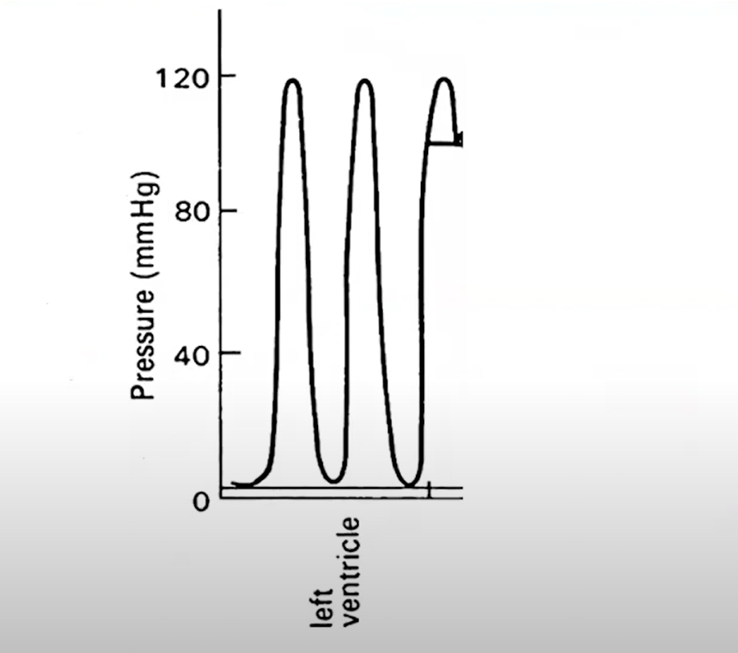
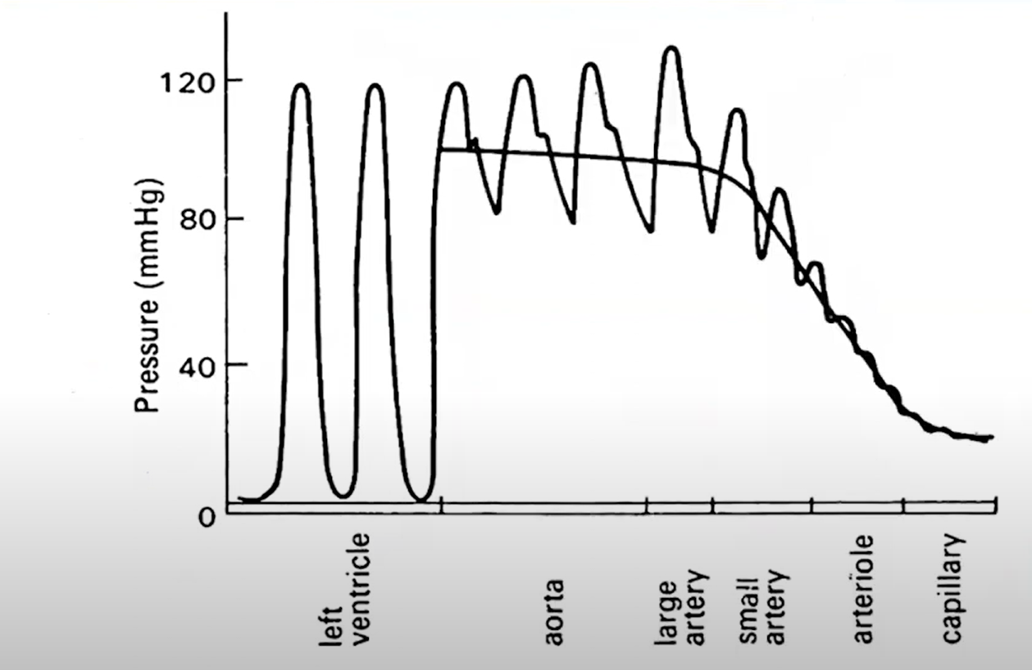
Normal Physiology
Notes:
Normal physiology
LV can generate an enormous amount of pressure (Systolic pressure or 120 mmHg). First generation pumps tried to mimick this. - as you can see with pulsatility- pulse pressure is around 40 mmHg in the aorta. As you progress through the smaller vesses, that pulsatility decreases and the pulse pressure decreases. This narrow pulse pressure is more resembling of the later generation LVADs. (can still perfuse at lower pulse pressures)

Slide 16
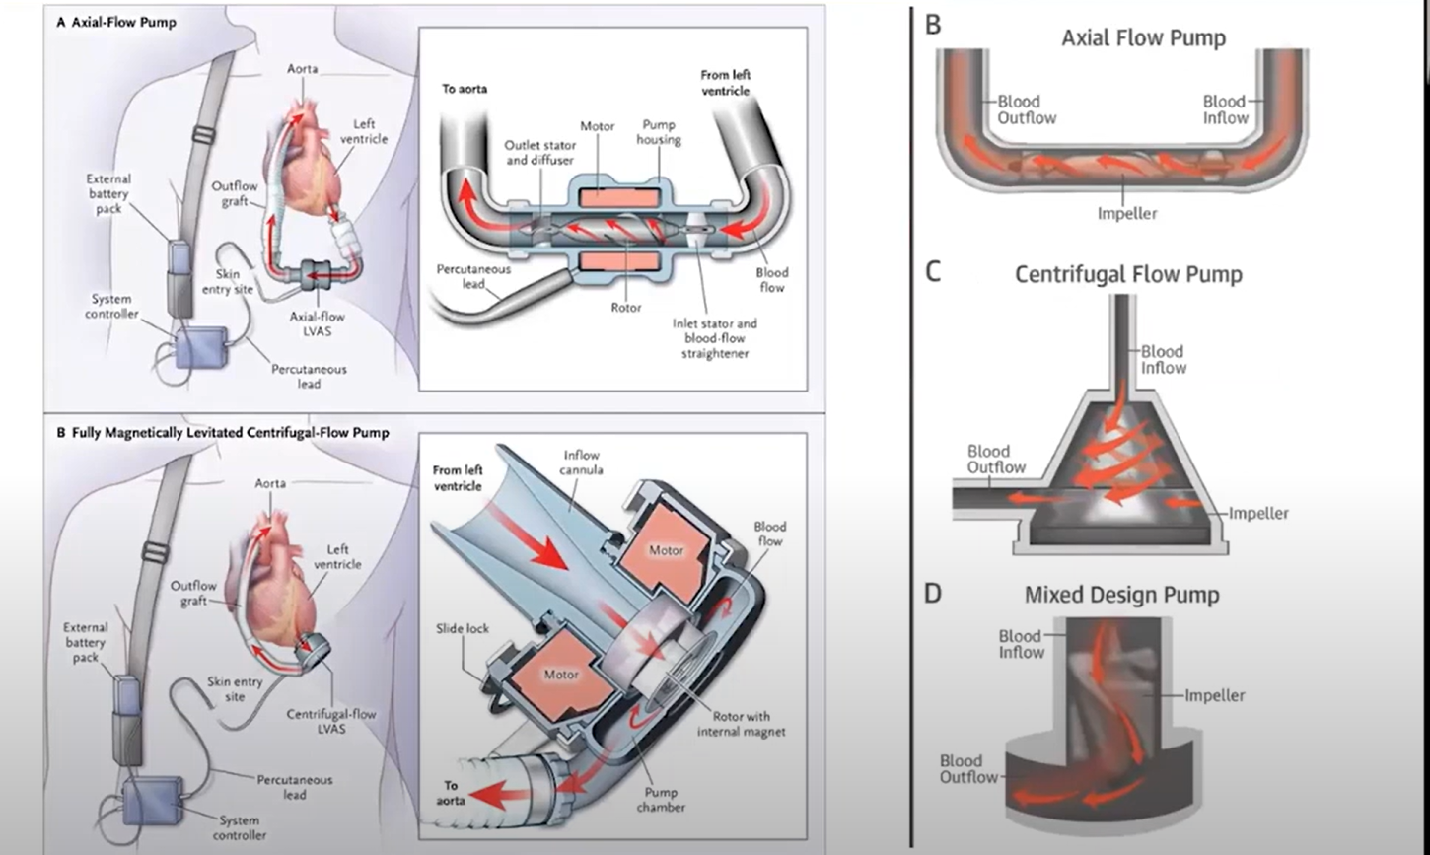
Fully levitated, self-centering rotor- does not require hydrodynamic or mechanical bearings
Large, consistent blood flow pathways to reduce shear stress
Intrinisic pulsatility to reduce stasis and minimize thrombus
Notes:
Full MagLev Flow technology- maintains gentle blood handling to minimize complicatins and reduce hemocompatibility-related adverse events
Fully levitated, self-centering rotor- does not require hydrodynamic or mechanical bearings (minimizes contact with the surface)
Large, consistent blood flow pathways to reduce shear stress
Intrinisic pulsatility to reduce stasis and minimize thrombus

Slide 17
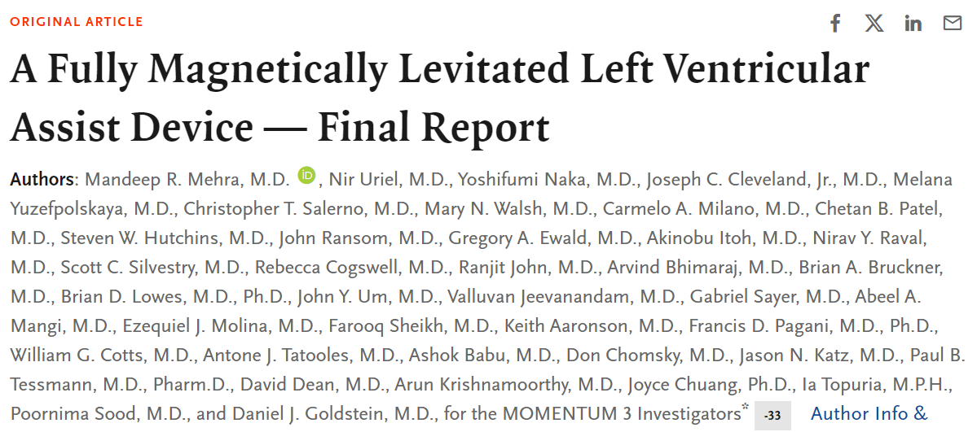
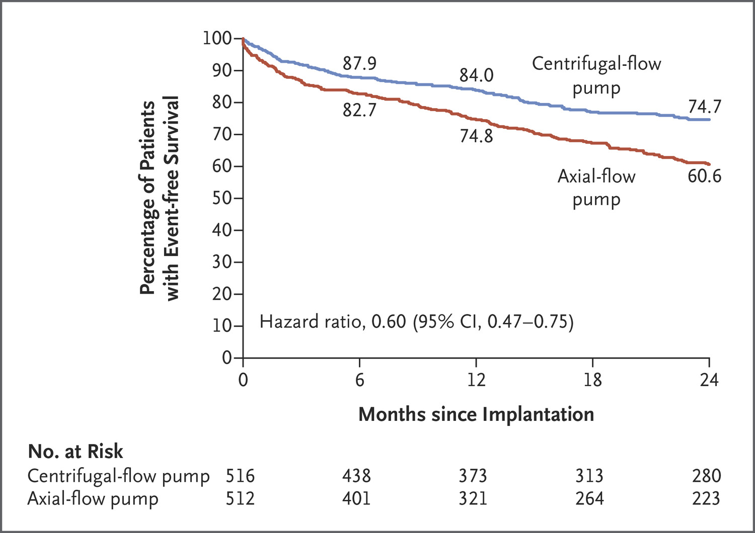
Notes:
Put Momentum 3 Study- Axial Flow and Centrifugal flow pump
1000 patients
Centrifugal pump vs axial flow pump
CF pump had higher event free survival (need for pump exchange, death). Secondary outcomes were bleeding and stroke

Slide 18
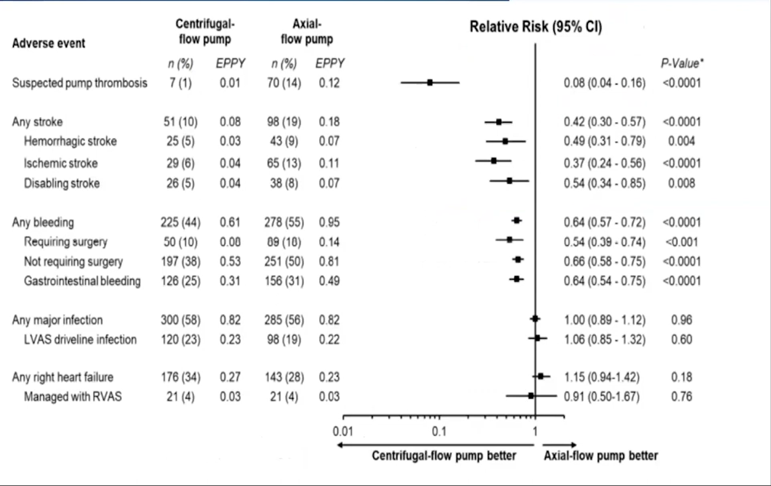
Notes:
Adverse event chart from MOMENTUM-3
In CF- pump group, had lower risk of suspected pump thrombosis, seemed to be signal to less stroke in bleeding, but no difference in RHF and infection

Slide 19
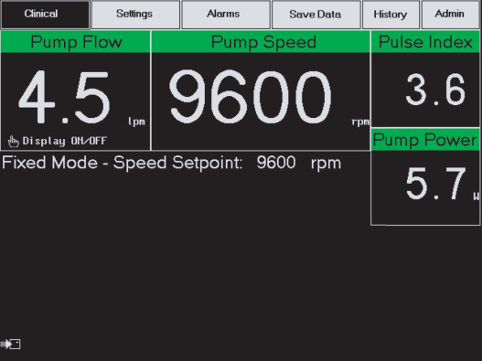
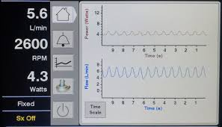
LVAD parameters

Slide 20
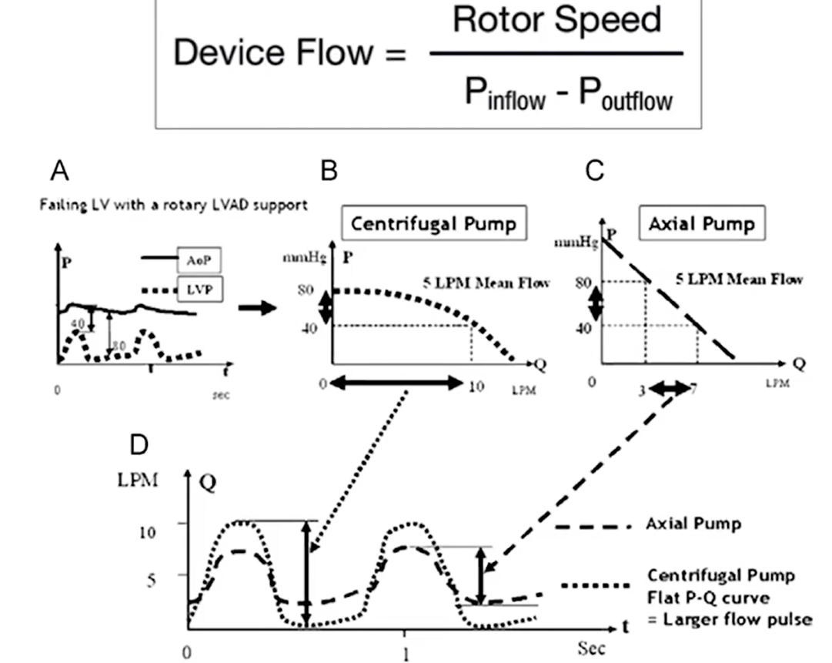
Notes:
LVAD physiology
Flow through an LVAD is directly proportional to the speed that we set the vad at
Also dependent on the pressure difference between the inflow and outflow
LVAD by definition are essentially dependent on preload and very sensitive to afterload
Depending on way the LVAD is spinning, there are differences on how the pump behaves.

Slide 21
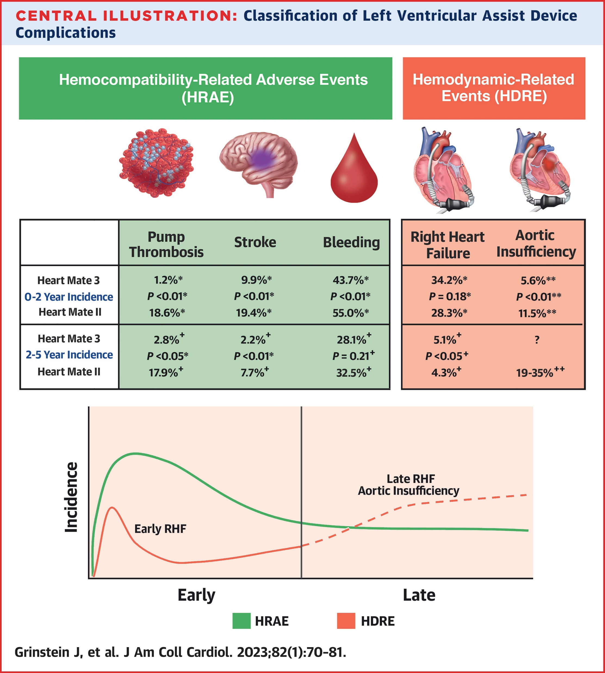
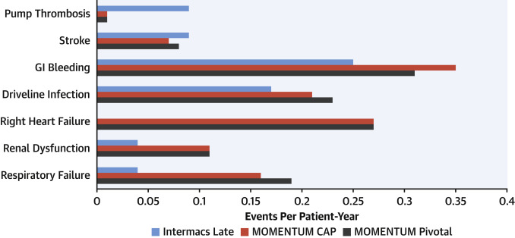
Complications of Durable LVAD implantation

Slide 22
Contraindications to LVAD implant
Limited life expectancy
Active malignancy
Age > 80 years old
Severe comorbidities that would preclude meaningful outcome
End Stage Renal disease with GFR < 30
Severe liver disease including cirrhosis or presence of portal hypertension
Hematologic
Active severe bleeding
Inability to tolerate anticoagulation
Anatomic barriers
Restrictive cardiomyopathy
Hypertrophic cardiomyopathy
Severe right heart failure
Inability to care for LVAD

Slide 23
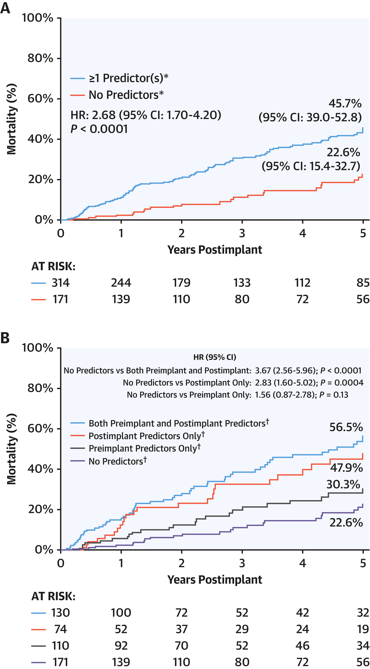
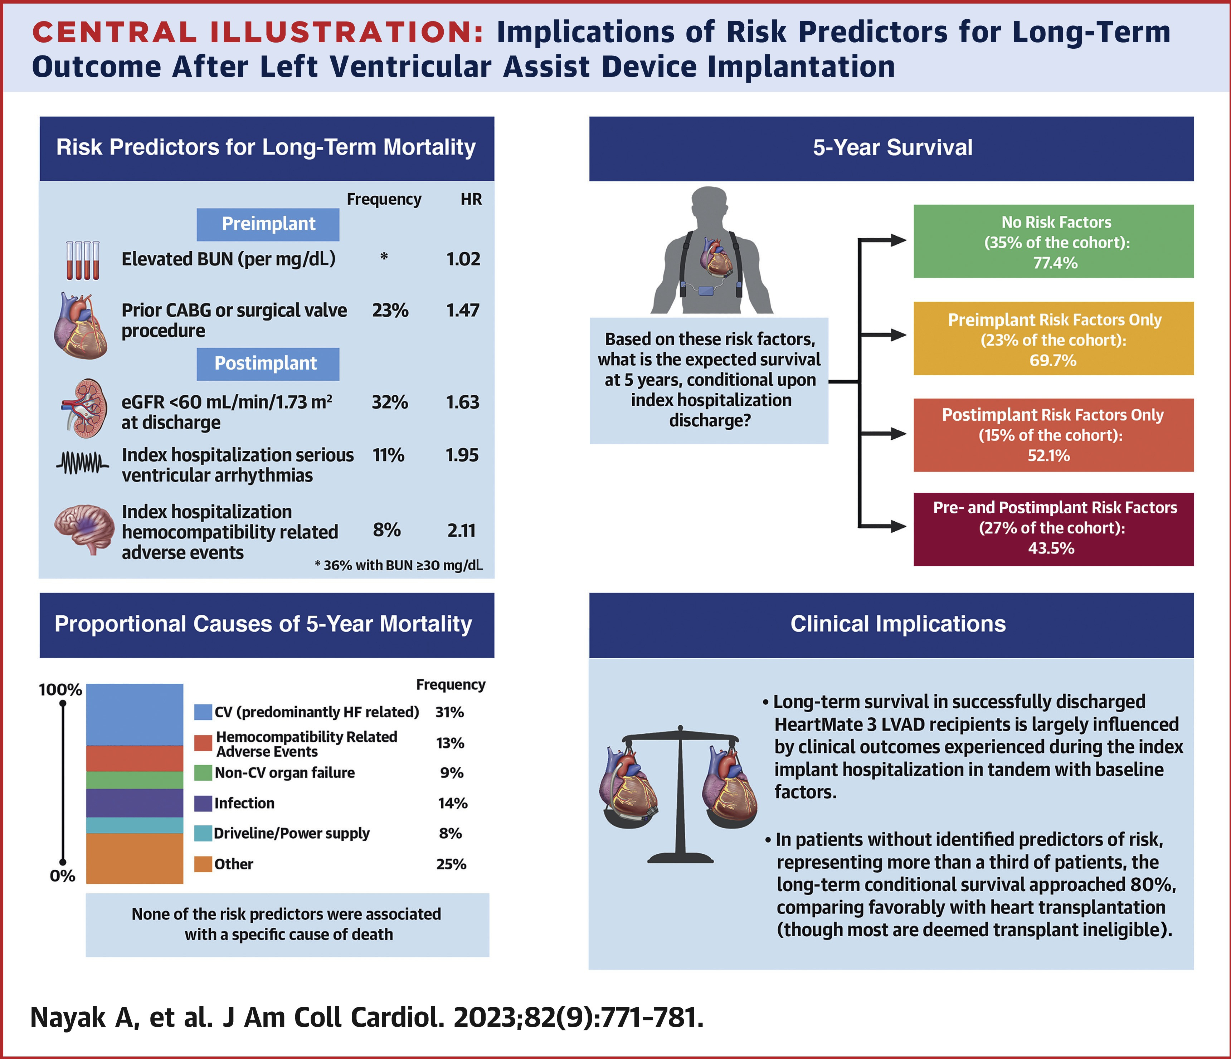
What are the outcomes after LVAD implantation?
Notes:
Long-term survival in successfully discharged HM3 LVAD recipients is largely influenced by clinical events experienced during the index surgical hospitalization in tandem with baseline factors, with mortality of <50% at 5 years
Patients without mortality risk predictors (baseline BUN ≥30 mg/dL, prior valve procedure or CABG, HRAE during the index hospitalization, serious ventricular arrhythmias during the index hospitalization, eGFR at discharge <60 mL/min/1.73 m²) represented 35.3% of the total cohort (n = 171) and experienced a reduced mortality rate of 22.6% (95% CI: 15.4%-32.7%) at 5 years

Slide 24
Cardiac Transplantation

Slide 25
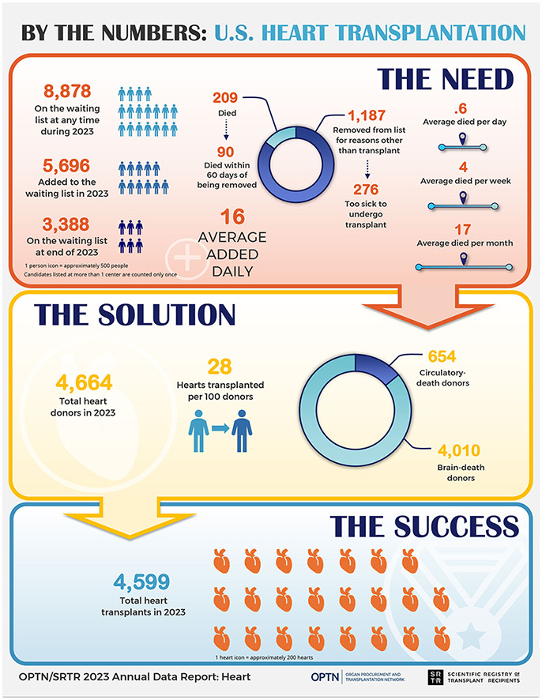
Introduction to Transplant

Slide 26
Indications for Cardiac Transplant
Absolute
Severe hemodynamic compromise due to HF as defined by refractory cardiogenic shock requiring intra-aortic balloon pump or mechanical circulatory support
Dependence on intravenous positive inotropic support to maintain vital organ perfusion
Severe symptoms of ischemia not amenable to surgical or percutaneous revascularization
Recurrent, symptomatic ventricular arrhythmias refractory to medical therapy or catheter ablation.
NYHA Class III/IV Symptoms despite optimal medical therapy and/or resynchronization therapy
End-stage congenital heart disease without evidence of irreversible pulmonary hypertension
Relative
Recurrent, unstable ischemia not amenable to intervention
Recurrent, unstable fluid balance/renal function not due to patient nonadherence with medical therapy.
Peak VO2 <12 ml/kg/min
Poor prognosis as based on Heart Failure Survival Scores
>14ml/kg/min

Slide 27
Contraindications to Transplant
Absolute
Advanced irreversible renal failure with Cr >2 or creatinine clearance <30-50 mL/min without plans for concurrent renal transplant;
Advanced irreversible liver disease;
Advanced irreversible pulmonary parenchymal disease
Advanced irreversible pulmonary artery hypertension
History of solid organ or hematologic malignancy within the last 5 years due to probability of recurrence.
Relative
Severe peripheral vascular disease
Severe cerebrovascular disease
Severe osteoporosis
Severe obesity (BMI >35 kg/m²) or cachexia;
Acute pulmonary embolism
Active infection (excluding LVAD-related infections)
Advanced age (>70 years old);
Psychological instability (e.g., PTSD)
Active or recent (within 6 months) substance abuse (alcohol, cocaine, opioids, tobacco products, etc.)
Diabetes mellitus with end organ damage
Lack of social support or sufficient resources to permit ongoing access to immunosuppressive medication and frequent medical follow-up.
Mancini D, Lietz K. Selection of cardiac transplantation candidates in 2010. Circulation 2010;122:173-83

Slide 28
Evaluation of Cardiac Transplantation Recipient
Right and Left Heart Catheterization
Cardiopulmonary testing
Labs
CMP, CBC, UA, PT/INR, TSH
UDS, ETOH level,
Infectious work-up including HIV, Hepatitis panel, PPD, CMV IgG, RPR / VDRL,
Immunology work up: PRA (panel of reactive antibodies), ABO and Rh blood type
Comprehensive imaging
Chest xray
CT chest/abd/pelvis
Carotid ultrasound
ABI/PVR or lower extremity ultrasound
PFT’s including DLCO
Substance abuse history and evidence of abstinence for at least 6 months and enrollment in formal rehabilitation.
Mental health evaluation including evidence of social support
Age appropriate malignancy screening

Slide 29
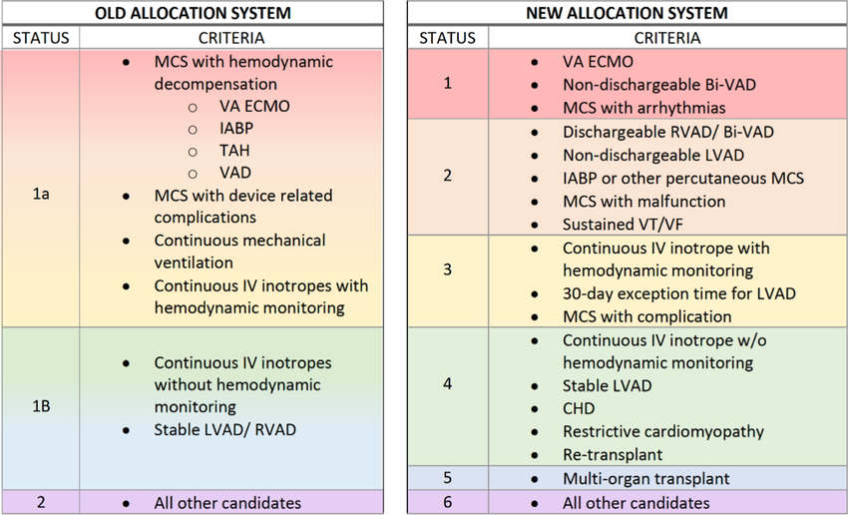

Slide 30
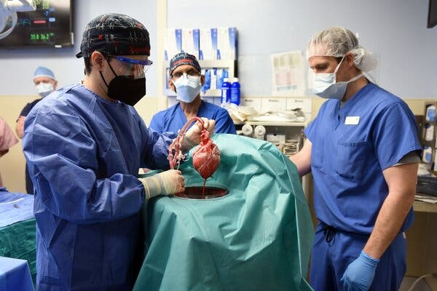
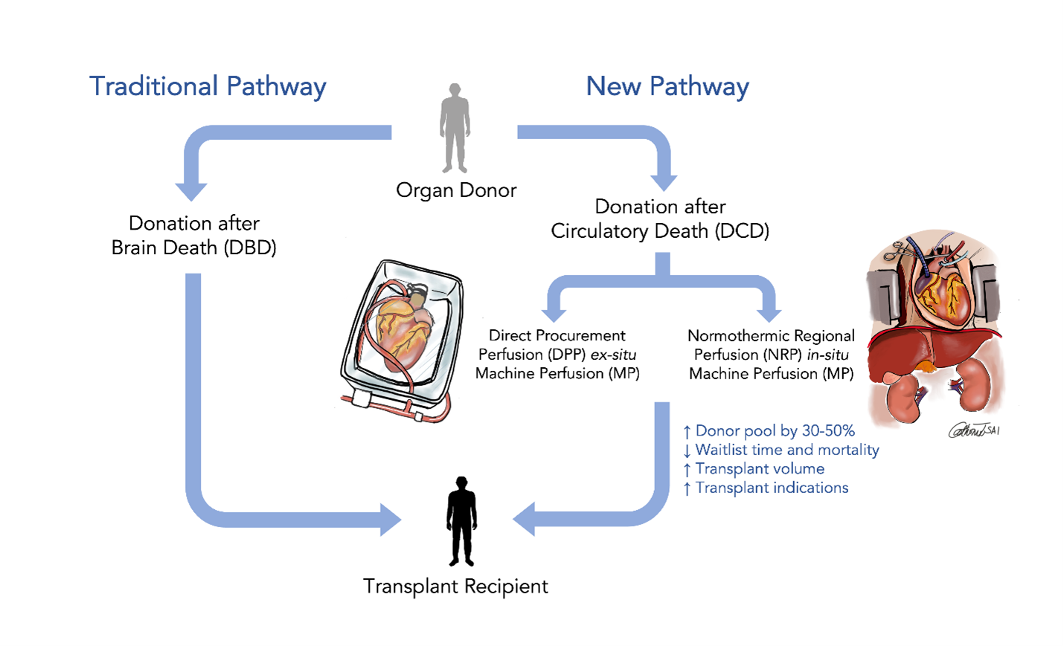
Procurement
https://unos.org/news/understanding-donation-after-circulatory-death-dcd/
Notes:
DCD refers to the recovery of organs from a patient who has died due to the irreversible loss of circulatory and respiratory function — when the heart has stopped beating and cannot be restarted. This is distinct from Donation after Brain Death (DBD), where death is declared based on irreversible loss of brain function.
Typically, DCD is an option after a patient has suffered a catastrophic neurologic injury but does not meet the medical criteria for brain death. The first step in the DCD process is the determination by the patient’s doctor that continued life-sustaining support of circulatory and lung function for this patient is futile, is not in the patient’s best interest, and that it should be withdrawn.

Slide 31
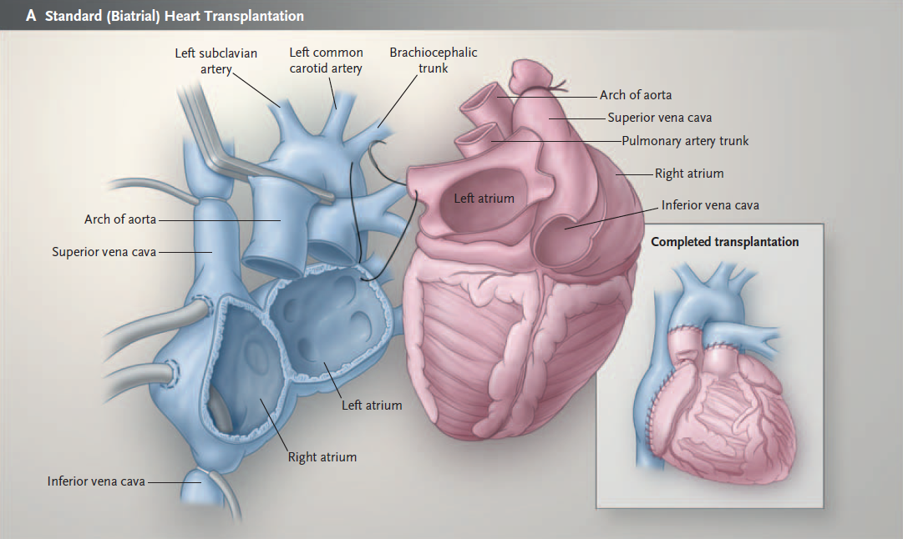
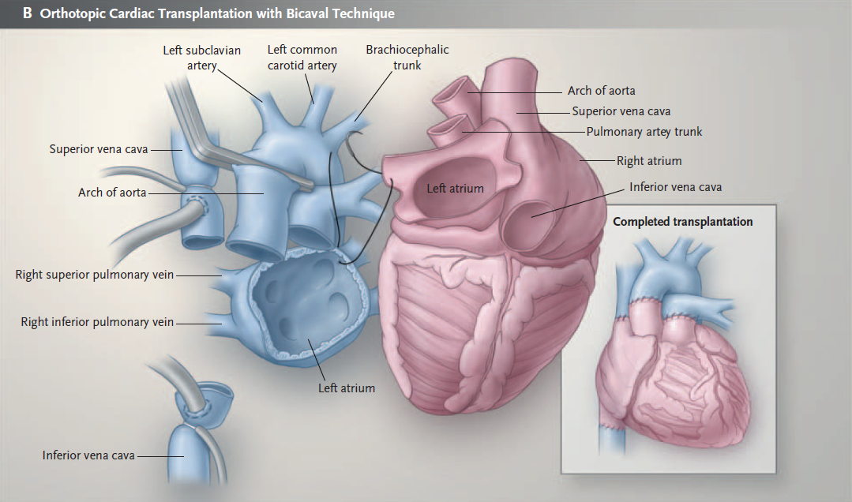
Surgical Techniques
Notes:
Biatrial (now less used)- connects donor hearts left atrial to receipient left atrial and donor right atrium to receipient right atrium- leaves more native atrial tissue
Pros: quickly, simpler surgery, shorter time. Cons: higher risk of arrhtymias, tricuspid regurgitation and atrial dysfunction
Bicaval: connects donor left atrial to receipient left atrium, but directly connects donor vena cavae (superior and inferior to recipients- preserved more natrive right atrial function
Pros: Better right atrial function and morphology and lower incidence of arrhtymias with better better sinus node function. Cons: more complex and takes longer to perform.

Slide 32
Immunosuppressive Strategies
• Induction
– Polyclonal anti-lymphocytes Ab: horse/rabbit ATG
– Anti-cytokine receptor Ab: Daclizumab/Basiliximab
– Monoclonal Muromonab CD3 [OKT3]
• Maintenance
– Corticosteroids (Methylprednisolone, prednisone)
– Calcineurin inhibitors (Cyclosporine, Tacrolimus)
– mTOR inhibitors (Sirolimus, Everolimus)
– Antiproliferative (Azathioprine, MMF)
• Rejection

Slide 33
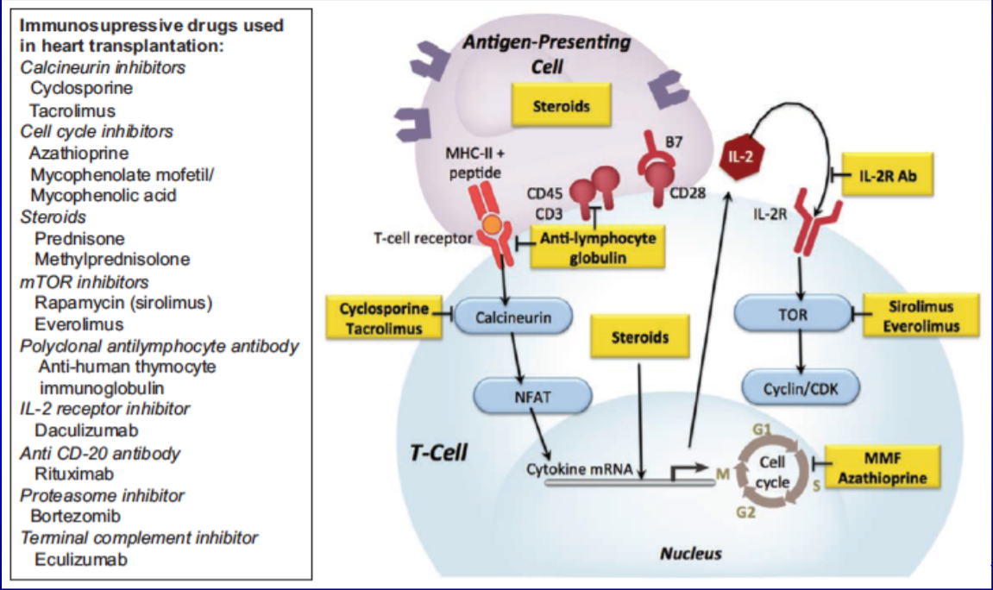
Post Transplant Immunosuppression
Stehlik J, et al. Circulation 2018

Slide 34
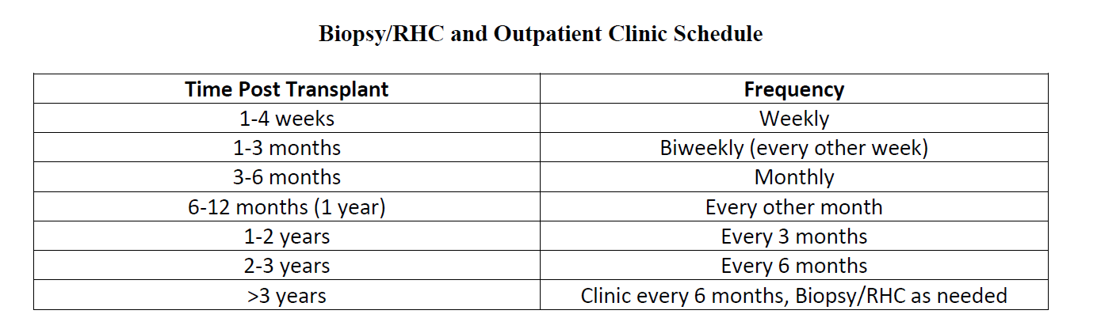
Rejection Surveillance

Slide 35
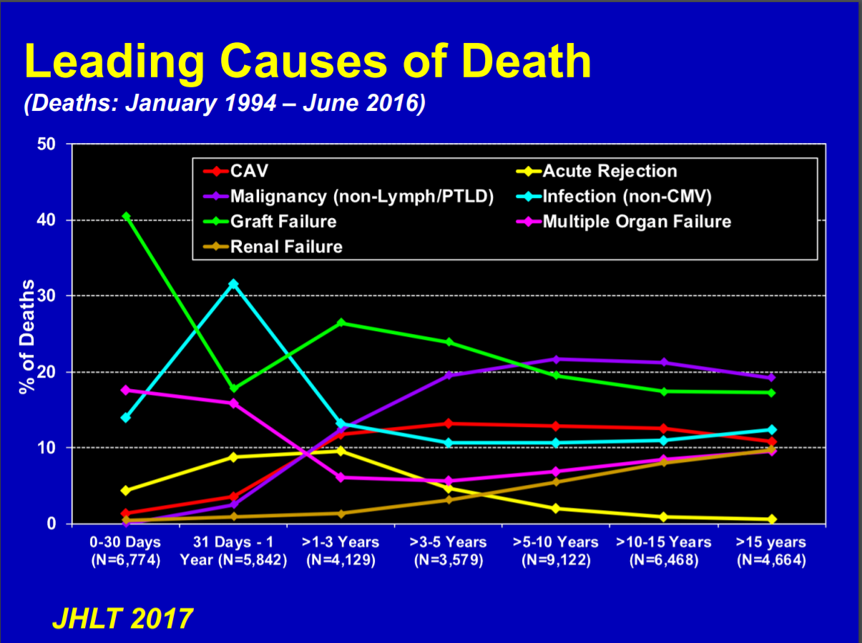
Post Transplant Complications
Rejection
Infection
Cardiac Allograft Vasculopathy
Malignancy

Slide 36
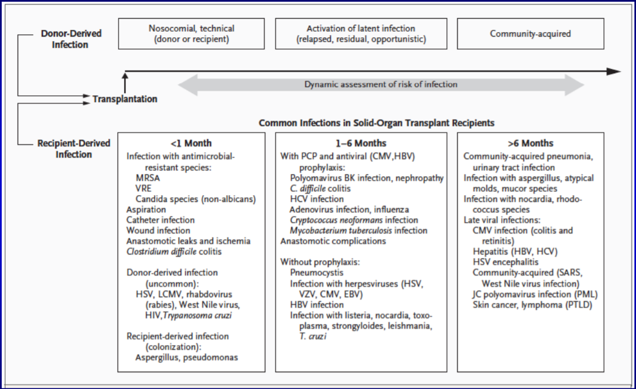

Slide 37
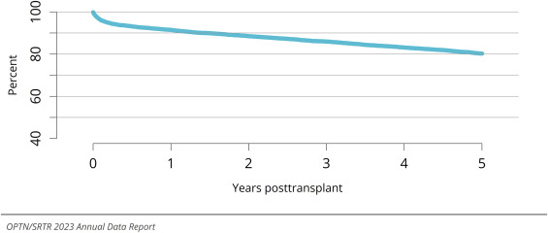
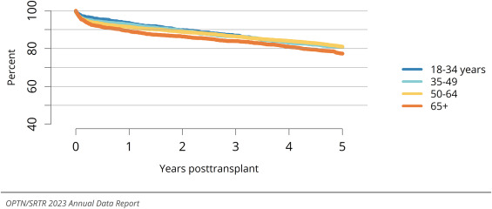
Overall survival
Among adult patients who underwent transplant in 2016-2018, the 5-year survival was 80.3%.
Overall 1-year and 3-year patient survival were 91.5% and 85.9%, respectively

Slide 38
Overall survival
Poor outcomes are associated with the following risk factors
Increased frailty
Congenital heart disease
Advanced pulmonary disease
Higher Intermacs classification

Slide 39
Key Points
Advanced heart failure is associated with high mortality and morbidity requiring early recognition and evaluation
Advanced therapies options for advanced therapies on this population include durable mechanical support (LVAD) or cardiac transplantation
LVAD therapy and heart transplantation require rigorous revaluation, however with early intervention, have good long term outcomes

Slide 40

Questions?
Notes:
Please include any references you have in your presentation.

